Slide 1
Type System in Hybris

Slide 2
Agenda
What is Type System.?
Different tags in Type System
Example of Creating a new item type.
Flexible search
Impex
CronJob

Slide 3
Type System
Hybris has a concept of Type System which is similar to the concept of class & object in java.
A type is a template or blueprint of an item. Every item (object) stored in the platform as a type (class) instance.
A type system is defined as a collection of different itemtypes declared in items.xml. Each item type is consist of a Java class which gives access to different members of itemtype through getter methods and set the values in them through setter methods. In addition to that, each item type has a database entity (table) associated with it.
Type = type definition in items.xml + its Java implementation (Model)

Slide 4
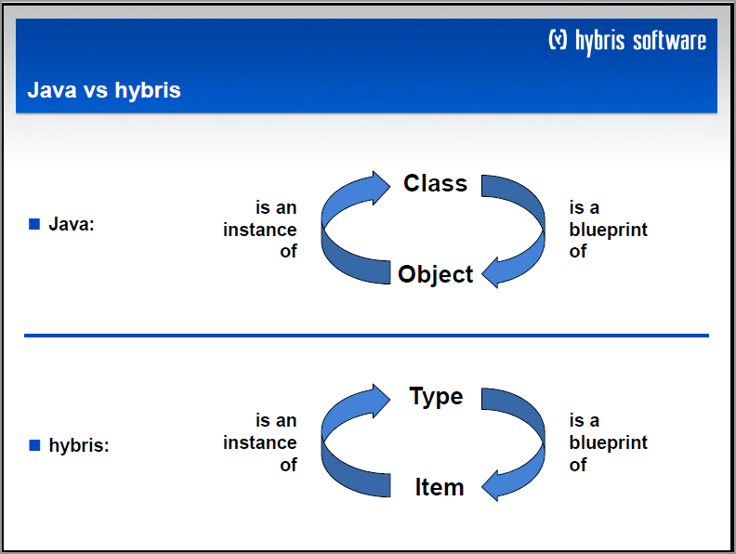

Slide 5
Items.xml
Items.xml file is a file that hold all the configuration related to the Hybris type system.
This file can be found at path ${HYBRIS_BIN_DIR}/${EXTENSION_FOLDER}/resource/${EXTENSION_NAME-items.xml}.
Each items.xml file will be validate by XSD file during the compile time. If Hybris found any validation rule violation then Hybris gives the compile error or Build get fail.
This XSD file is also located at same directory.

Slide 6
Tags in Items.xml File
There are six tags are available in Hybris type system. Each tags is described below:
Atomic Type
Collection Type
Enum Type
Map Type
Relation Type
Item type

Slide 7
Atomic Type
AtomicTypes are the most basic types available in the Hybris Commerce Suite. They are the representation of Java number and String object types, such as java.lang.Integer or java.lang.String.
Most probably you will not have to define AtomicTypes anyway. When you define an AtomicType yourself, you need to assign a Java class object to it.
The Hybris Commerce Suite stores AtomicType instances in the database as strings (VARCHAR) or numbers (NUMBER). If you define AtomicTypes yourself, you need to make sure that those types are serialisable (that is, you need to find a storage format for them that your database system can manage).
Below is the format to create a new Atomic Type:
<atomictypes>
<atomictype class="java.lang.String" extends="java.lang.Object" autocreate="true" generate="false"/>
</atomictypes>

Slide 8
Collection Type
A collection type in hybris type system is used to hold the more than one value of homogeneous type in a single entity.
<collectiontypes>
<collectiontype code="StringCollection" elementtype="java.lang.String" autocreate="true" generate="false"/>
</collectiontypes>
Note:
elementtype: Type of the element that collection will hold.
code: unique code for the collection.
Every item should be enclosed into the types tag such as above, collectiontype is defined inside the collectiontypes tags, because to separate the different tags and their position into the file.

Slide 9
ENUM Type
ENUM types are the constants into the hybris type system.
Enum hold the fixed set of values.
Example: On payment page we have one field type of card such as visa, master card, rupay etc. we can select one value from the drop down. This field is Enum type in hybris. Because type of the card is fixed and rarely alter.
<enumtype code="CreditCardType" autocreate="true" generate="true">
<value code="amex"/>
<value code="visa"/>
<value code="master"/>
<value code="diners"/>
</enumtype>
Note:
code: unique code of the enum type and should be unique in hybris type system.
Different values are given which we can say predefined values for this enum type.

Slide 10
Map Type
Map type in hybris type system is much similar like java map.
In hybris type system, map also hold the key value pair same as a java map.
In map type, argumenttype is a key and returntype is value.
Example:
<maptypes>
<maptype code="localized:java.lang.String“ argumenttype="Language“ returntype="java.lang.String" autocreate="true“ generate="false"/>
</maptypes>
This map will hold the string value for different locales (different languages).
Note:
code: should be unique in hybris type system.
Argumenttype: key
Returntype: value

Slide 11
Relation Type
Relation Type is used to make the link in between the two items which is should be exist into the hybris system.
This tag will make the relation in between the two items of the hybris.
This tag contain only two field, one is sourceElement and another is targetElement .
It hold the relation cardinality i.e relation between the item types such one to many, many to many.
<relations>
<relation code="ProductReferenceRelation" generate="true" localized="false" autocreate="true">
<sourceElement qualifier="source" type="Product" cardinality="one">
<modifiers read="true" write="false" initial="true" optional="false" unique="true"/>
</sourceElement>
<targetElement qualifier="productReferences" type="ProductReference" cardinality="many" ordered="true" collectiontype="collection">
<modifiers read="true" write="true" optional="true"/>
</targetElement>
</relation>
<relations>

Slide 12
Item type
Item type is a tag in it self into the hybris type system.
It contains the attributes and their property.
Item type create a structure of the data base.
Example:
<itemtype code="ProductInfo“ autocreate=“true” generate=“true”>
<deployment table="AbstrCfgProductInfo" typecode="131" />
<attributes>
<attribute qualifier=“name" type=“java.lang.String">
<modifiers optional="false" write="false" initial="true"/>
<persistence type="property" />
</attribute>
</attributes>
</itemtype>

Slide 13
Example to create a New Item type in Hybris

Slide 14
Flexible Search Query
Flexible search is an abstraction layer on the sql query which is given by the hybris.
It can be used to fetch the data from the database by executing the query.
It is similar like an any sql query.
In the flexible search query we use the type definition instead of the database tables or column name. because hybris does not provide any access to the database.
We enclosed the item type and attributes into the curly braces ({})
Hybris Execute the flexible in two steps:
Transform the flexible search query into the sql query.
Execute the sql query on the data to fetch the details.
Example:
Select {name} from {Product} where {code}=‘12345’

Slide 15
Impex
Impex stands for the Import and Export.
Import: Import the data into the database.
Export: Export the data from the database.
Impex (For Import) we use the 4 types of the operation/mode that called Header.
INSERT: To insert the new value into table only.
UPDATE: To update the existing value of the row in a table.
INSERT_UPDATE: To insert or update the row.
REMOVE: To remove the row.
Impex contain below lines:
Header: Header to used to specify the type and its column on which insert/remove/update would be performed.
Value lines (Row that would insert/remove/update into the database)

Slide 16
$productCatalog=powertoolsProductCatalog
$productCatalogName=Powertools Product Catalog
$catalogVersion=catalogversion(catalog(id[default=$productCatalog]),version[default='Staged'])[unique=true]
$supercategories=supercategories(code, $catalogVersion)
# Language
$lang=en
INSERT_UPDATE Product ;code[unique=true] ;$catalogVersion[default=$catalogVersion]
;AstinProduct ;

